Slide 1
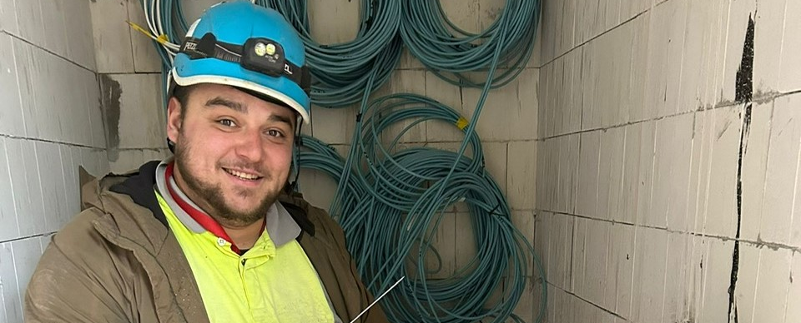


Quote Here
Dmytro
Ukrainian Employee
Country
Poland
Website
If a community organization or employer, how was integration achieved?
Community Initiative
Employer
Refugee
Public Policy or National Scheme
How was integration achieved?​
By spending time together at work and after work with Polish colleagues. Thanks to the company, I had employee housing. The company trained me as a construction electrician. It funded all courses, training, and paid for exams. The practical experience gained on construction sites is also invaluable.​
Did you integrate on your own into the community?
I came to Poland with my parents. Thanks to that, I didn’t feel lonely. Working with Poles greatly helped me integrate. I quickly had to learn the Polish language and the local culture.

Slide 2
What level of the local language do you have?
What supports
were provided?
Very good. I communicate excellently at work and outside of it, participate in professional training, and take exams in Polish.
The company funds courses, training, and exams. Additionally, construction manufacturers invite us to free workshops​
Do you provide upskilling workshops in your organization or company?
Was any funding used to put into place supports lacking?
All the time. In the construction industry, new technical solutions appear constantly. To be a good employee, I need to participate in training almost non-stop.​
​
The city subsidized housing. The company finances training and work attire. It’s all fine.

Slide 3
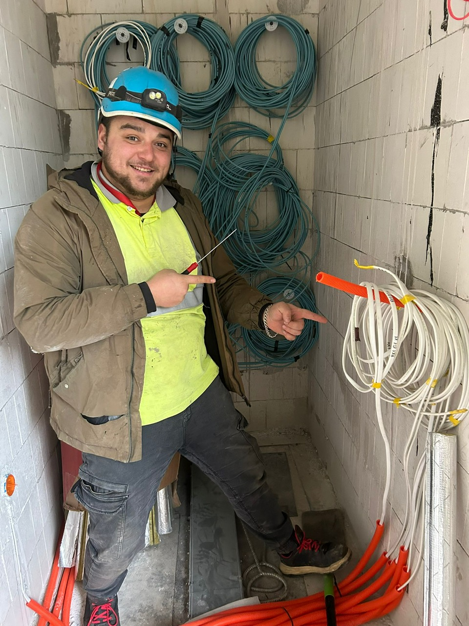
Was enough support given to you by the community organization or employer?
Yes, the support from the city was invaluable. Thanks to the company’s funding, I have a well-paying profession and know Polish, including technical terminology.
Quote here
If a community organization
or employer, how was the integration of refugees
successful for you?
Yes, thanks to the support, I have a profession, a well-paying job, and I can calmly think about the future
As a refugee, how did you achieve success in adapting to your new work surroundings?`
To survive, I had to quickly learn Polish and a new profession. Thanks to the support of the city and the company, I succeeded.
www.welcomeworkproject.eu

