Slide 1
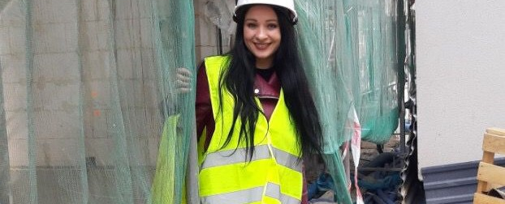


Quote Here
KARIERA NA PLUS SP. Z O.O.
Country
Poland
Website
https://karieraplus.com/
If a community organization or employer, how was integration achieved?
Community Initiative
Employer
Refugee
Public Policy or National Scheme
Daily interactions at work with Polish citizens and direct collaboration with Polish contractors and suppliers allowed our employees to fully integrate with the Polish community. Additionally, participation in vocational training and workshops organized or funded by our company enabled employees to further enhance their professional skills. Evening gatherings organized by the foundation were excellent opportunities to engage with Polish culture and language.​
Did you integrate on your own into the community?
The integration process began with me actively encouraging our employees from Ukraine and Moldova to participate in events co-organized by my company and the "Kreator Wiedzy" foundation (Knowledge Creator foundation), which we sponsor. Workshops and vocational training conducted in Polish, which also included Polish participants, were a great way to foster integration. Participation in these events was free for our employees, often funded by Kariera Plus Sp. z o.o. (Career Plus Ltd.)​
I also made efforts to ensure our employees worked in teams with Polish colleagues.​

Slide 2
What level of the local language do you have?
What supports
were provided?
Due to the lack of language, companies have done their best to support employees with Polish language skills as it’s essential for work. They’ve organized Polish language courses. The initiative has given employees the skill to communicate fluently at work, independently handle matters at the office, and pass professional exams in Polish.​
​
​
Thanks to the company, employees from Ukraine and Moldova can learn Polish for free, familiarize themselves with Polish culture, and obtain relevant professional certifications. They help them find rental housing, advise on the terms of signing agreements with landlords, and assist in handling administrative matters, such as filling out 800+ applications and many other issues too.​
Do you provide upskilling workshops in your organization or company?
Was any funding used to put into place supports lacking?
Construction workers must regularly enhance their qualifications to stay competitive in the job market. The company constantly must learn new technologies and have the workers obtain professional certifications. Courses and training are conducted in Polish so therefore, employees systematically participate in events organized by the company, contractors, and suppliers of construction materials.​
Subsidies are available for rental housing (governmental support for lessors). The employees receive their work uniform for free. In addition, the company funds language and vocational courses along with the exams.​
​
​

Slide 3
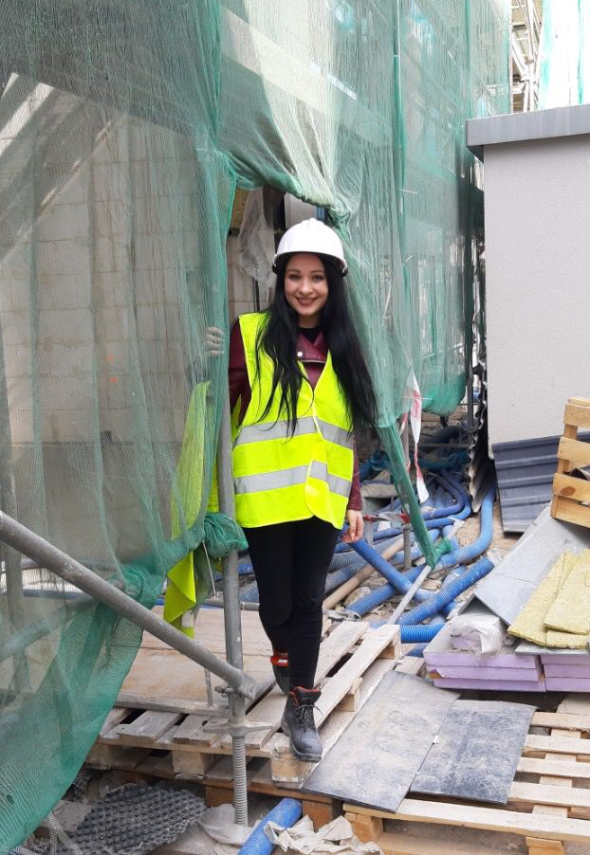
Was enough support given to you by the community organization or employer?
​
Yes, thanks to the support of the company and the "Kreator Wiedzy" foundation, employees are fluent in Polish and are qualified professionals in the Polish market. This allows them to afford a decent life in Poland, often including buying an apartment with a mortgage or educating their children. Thanks to the support, most employees plan to stay in Poland permanently.​
​
Quote here
If a community organization
or employer, how was the integration of refugees
successful for you?
​
Integration has been a success. The assistance provided has allowed employees to fully integrate in Poland. They have a profession, speak Polish, earn appropriate salaries, and have legal employment, enabling them to plan for retirement. Most of the workers plan to stay in Poland permanently.​
​
As a refugee, how did you achieve success in adapting to your new work surroundings?`
www.welcomeworkproject.eu

