Slide 1
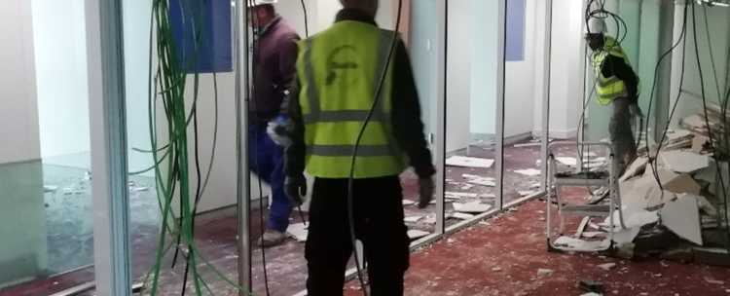
The circular economy market is now benefiting from unprecedented visibility. Recent laws are forcing companies in the sector to review their operations in order to give priority to the reuse and recycling of construction materials. We can conclude that the circular economy is a market with a promising future. It allows us to fundamentally rethink our approach to the economy and our society.
Aurelie Malvy, Tricycle Curage director
Reavie & Tricycle
Training refugees to re-use materials, a sector of the future for the building industry
Country
France
Website
Accueil
If a community organization or employer, how was integration achieved?
Community Initiative
Employer
Refugee
Public Policy or National Scheme
Before being recruited, the employee is first interviewed by our teams (ideally a social worker and a technical supervisor), after being referred by our social partners. This is when we can explain in detail what we do and how our sites work. This allows us to check that the person understands the job and to see if it's right for them.
Then, on his or her first day, the employee is received by our social worker, who explains all the administrative details of the contract and explains the various training options available... Then the work experience begins! After that, there are many social events to facilitate integration, one being barbecues!
Did you integrate on your own into the community?
Click here to answer…

Slide 2
What level of the local language do you have?
What supports
were provided?
The low level in French is often the main barrier to employment among refugees employed in structures such as Tricycle and Reavie. The work-integration programs specifically allow for French courses during working hours.
Réavie and Tricycle employees are referred by local social partners. They sign an integration contract (CDDI), which provides them with social support and access to training, including French language courses, while at the same time working hours on various sites, with a technical supervisor on hand to help them with their work and posture. They can then sign an ordinary contract with the company, or take advantage of this experience to join another company in the construction industry or in another sector.
Reuse techniques in the building industry offer a wide range of occupations, which are becoming increasingly recognized and are helping to create the conditions for a sustainable society. For example, a recovery technician who observes the reuse of building materials, an urban metabolizer, and a reuse carpenter..
Do you provide upskilling workshops in your organization or company?
External partners are mobilized to provide a diverse range of workshops according to the needs and wishes of the employees. It includes mandatory health safety trainings, language courses, cultural activities, drivers license, various manual handling certificates, and technical vocational trainings.
Was any funding used to put into place supports lacking?
Tricycle and Reavie are social integration companies: they receive state subsidies for their jobs, but their economic model is based primarily on their commercial sales. Their ability to offer stable jobs therefore depends on the volume of work they carry out.
Access to additional public subsidies and private fundings is often crucial. Public support can take the form of public procurement contracts that require the use of integration companies, reserved contracts or social clauses.
In addition, we note that changes in regulations and laws support Réavie and Tricycle's re-use activities (AGEC law, EU directives, etc.), and de facto offer significant professional opportunities for its employees, in a sub-sector that is gradually becoming a source of employment.

Slide 3
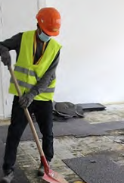
Was enough support given to you by the community organization or employer?
"First of all, the hardest part was relearning all the tool words in the language here. For example, hammer.
Then I was taught how to use the machines properly; where I'd learnt back home a lot more things were done by hand."
Ali, Reavie's employee
Click here to answer…
If a community organization
or employer, how was the integration of refugees
successful for you?
When the whole site team works well together, it's a success.
If people have had a better chance of fulfilling their personal wishes, whether in the construction industry or elsewhere, that's the best success!
As a refugee, how did you achieve success in adapting to your new work surroundings?`
Click here to answer…
www.welcomeworkproject.eu

