Slide 1
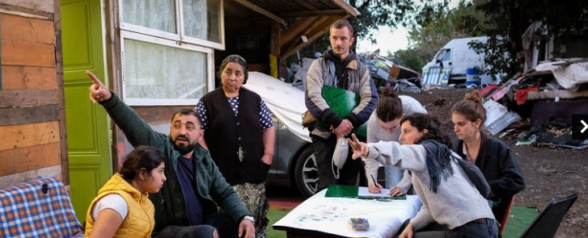


Our approach is to design spaces and refurbish homes, but to do so with the people who are the first to be affected. That's another reason why we work a lot with participative projects.
Thomas Henrion, coordinator
Association Quatorze
Designing and building with local communities
Country
France
Website
Quatorze - Accueil
If a community organization or employer, how was integration achieved?
Community Initiative
Employer
Refugee
Public Policy or National Scheme
IIntegration is achieved by focusing on developing the right partnerships for each project (universities, local associations, mediators, local authorities, etc.).
These partnerships make it possible to work together on both the design of the architectural project (light housing, shared gardens, tiny houses) and its construction in participative work camps, with future users as well as volunteers.
Did you integrate on your own into the community?
Click here to answer…

Slide 2
What level of the local language do you have?
What supports
were provided?
For its construction projects the association adapts to the community languages, and if needed mobilizes translators.
The association conducts participative projects aimed at improving the quality of life, particularly in areas suffering from poor access to essential services. At the moment, three pilot projects are carried out to house refugees.
In 2021, a special training session was aimed entirely at beneficiaries of international protection, with trainees working on the construction of a tiny house. In addition to the wood construction module, they were given professional support by Acina and French courses in wood construction by the Thot school.
Do you provide upskilling workshops in your organization or company?
Was any funding used to put into place supports lacking?
The association has developed LAB14, a manufacturing workshop that hosts training courses in wood and ecological construction. The workshop enables people who have missed out on employment to learn how to use both digital and more traditional manufacturing tools, and to understand the logic behind the production of a built object.
It depends on the projects. Some can be partly funded by universities as they take the form of action-research projects.
.
In addition, the projects are based on the participation of all the members, which means that the collective energy of the participative building sites means that they do not involve the traditional construction costs.

Slide 3
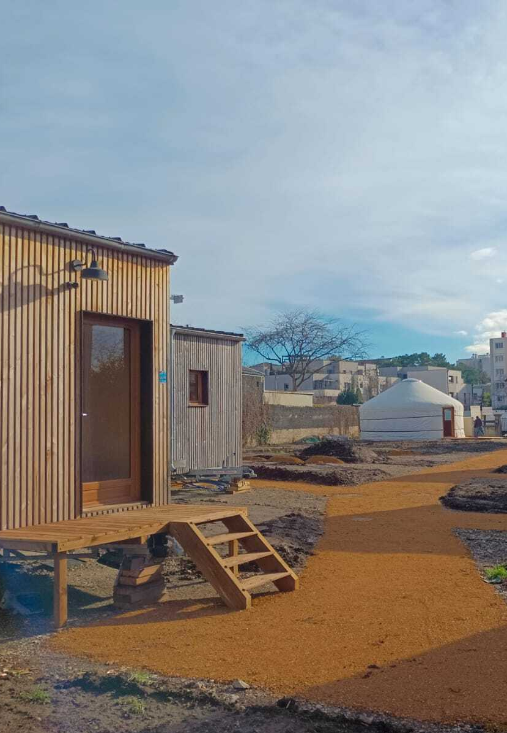
Was enough support given to you by the community organization or employer?
The local roots of these projects mean that they are often supported by local authorities and local stakeholders, that are invited to integrate the project.
"You know, this is the first time in the two years I've been in France that I've actually met French people!"
Nasurddin, volunteer participant in a Quatorze participative worksite
If a community organization
or employer, how was the integration of refugees
successful for you?
First, it is important to take stock of existing integration policies. This involves looking at all the European initiatives promoting the integration of exiles through housing, at regional and local level, but also at the level of individual practices. This comparison of reception and integration situations will make it possible to identify best practices.
This will help in favouring the integration of the refugees in the project as soon as the conception phase starts.
As a refugee, how did you achieve success in adapting to your new work surroundings?`
Click here to answer…
www.welcomeworkproject.eu

